Slide 1
Advanced Database Topics Database Concepts "a little Redis… a little Mongo"
Notes:
Replace this with your course title and your name/contact details.

Slide 2
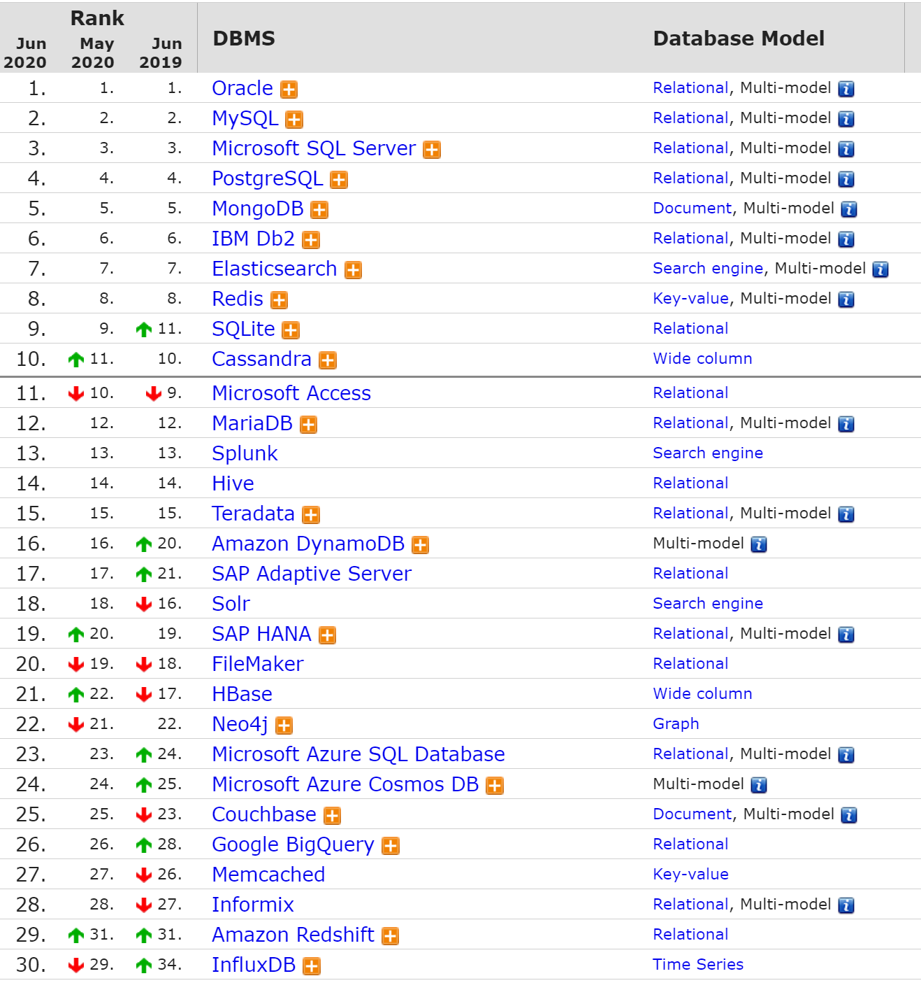






Top 25
Database Systems

Slide 3
Top 10 Web Frameworks
Rank | Framework |  | Github Score | Stack Overflow Score | Overall Score
1 | React | Javascript | 99 | 96 | 97
2 | ASP.NET MVC | C# |  | 95 | 95
3 | Angular | Javascript | 90 | 96 | 93
4 | Ruby on Rails | Ruby | 88 | 99 | 93
5 | AngularJS | Javascript | 90 | 97 | 93
6 | Vue.js | Javascript | 100 | 85 | 92
7 | Django | Python | 89 | 96 | 92
8 | Laravel | PHP | 90 | 93 | 91
9 | Spring | Java | 86 | 94 | 90
10 | ASP.NET | C# | 79 | 100 | 89
11 | Express | Javascript | 88 | 86 | 87
12 | Flask | Python | 89 | 82 | 85
13 | Symfony | Symfony | 82 | 86 | 84
14 | Meteor | Javascript | 87 | 80 | 83
15 | CodeIgniter | PHP | 79 | 86 | 82
What about Node.js? Node.js expands the JavaScript language by providing a larger set of runtime environment primitives—those which are outside the scope of ECMA's standards. These include things like file I/O. This means that Node.js changes the language and is in some sense a new language: "Node.js JavaScript"
Powerful, but not normally considered a framework.
https://hotframeworks.com/

Slide 4
Other Databases

Slide 5
Dynamo DB
Amazon DynamoDB is a key-value database (like Redis) and a document database (like MongoDB)
It is a highly available and scalable distributed data store built for Amazon’s platform.
Dynamo is used to manage the state of services that have very high reliability requirements and need tight control over the tradeoffs between availability, consistency, cost-effectiveness and performance.
Part of the Amazon architecture stack

Slide 6
CAP Theorem

Slide 7
CAP Theorem
CAP Theorem is a concept that a distributed database system can only have 2 of the 3:
Consistency
Availability
Partition Tolerance.

Slide 8
Imagine updating a distributed system, changing a Shape field from a square to a star.
1
2
The AP system -- sacrifice Consistency
Nodes 1 and 2 are always available, but an immediate read from node 1 says "star" while the immediate read from node 2 says "square"
The CP system -- sacrifice Availability
Node 2 knows that the record is being updated (Node 1 has locked it.) Node 2 has not failed, but it cannot return either the old value or the new value until it is updated over the network
The CA system -- handling NW partitions
Writes to either node will sacrifice Consistency (since we cannot update the other due to NW loss.) So…let's just keep both nodes available with the consistent old data until the NW is restored.
NW
W
R
1
2
NW
W
I can't answer. Sorry, not available
R
NW
partition
1
2
NW
partition
W
Both nodes must be consistent and available. I can only cache this write. Not commit it.
R

Slide 9
2 outta 3 ain't bad
"Allowing at least one node to update state will cause the nodes to become inconsistent, thus forfeiting C. Likewise, if the choice is to preserve consistency, one side of the partition must act as if it is unavailable, thus forfeiting A. Only when nodes communicate is it possible to preserve both consistency and availability, thereby forfeiting P. The general belief is that for wide-area systems, designers cannot forfeit P and therefore have a difficult choice between C and A." Eric Brewer, creator of the CAP Theorem

Slide 10
Perfect C&A
In the absence of NW partitions, let's all reply "square" to read requests until all of us know the new value is "star" This preserves both C and A. "Because partitions are rare, there is little reason to forfeit C or A when the system is not partitioned." – Eric Brewer
1
2
NW
W
Both nodes must be consistent and available. I can only cache this write. Not commit it.
R
NW
partition
1
2
NW
partition
W
Both nodes must be consistent and available. I can only cache this write. Not commit it.
R

Slide 11
ACID

Slide 12
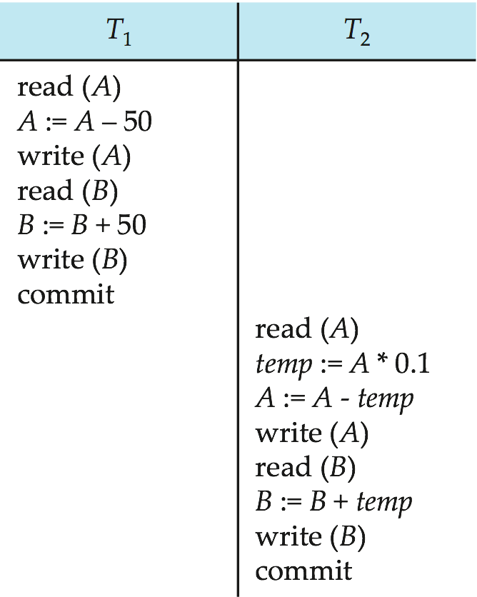
Transactions
Multiple actions can be wrappted in a single transaction.
Let T₁ transfer $50 from A to B, and T₂ transfer 10% of the balance from A to B.
Notes:
12

Slide 13
ACID
Atomicity. Either all operations of the transaction are properly reflected in the database or none are.
Consistency: The data is correct both before and after a transaction occurs. The database is in a state consistent with the intent of the transactions.
Isolation: Although multiple transactions may execute concurrently, each transaction must be unaware of other concurrently executing transactions. Intermediate transaction results must be hidden from other concurrently executed transactions.
Durability: Data persistence that ensures that when a transaction is complete, it can be retrieved in the event of a system failure.

Slide 14
Isolation Levels
The SQL standard defines four Isolation levels:
READ_UNCOMMITTED
READ_COMMITTED
REPEATABLE_READ
SERIALIZABLE
All but the SERIALIZABLE level are subject to data anomalies (phenomena) that might occur according to the following pattern:
Isolation Level | Dirty Read | Non-repeatable read | Phantom read
READ_UNCOMMITTED | allowed | allowed | allowed
READ_COMMITTED | prevented | allowed | allowed
REPEATABLE_READ | prevented | prevented | allowed
SERIALIZABLE | prevented | prevented | prevented

Slide 15
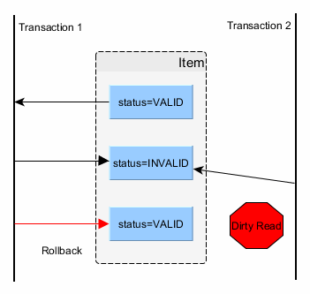
Dirty Read
A dirty read happens when a transaction is allowed to read uncommitted changes of some other running transaction.
This happens because there is no locking preventing it.
In the picture above, you can see that the second transaction uses an inconsistent value as of the first transaction had rollbacked.

Slide 16
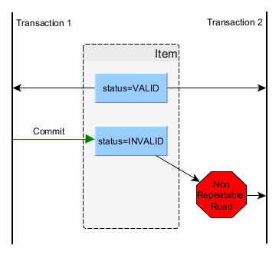
Non-repeatable Read
A non-repeatable read manifests when consecutive reads yield different results due to a concurring transaction that has just updated the record we’re reading.
This is undesirable since we end up using stale data.
This is prevented by holding a shared lock (read lock) on the read record for the whole duration of the current transaction.
What I am trying to read is being examined by another transaction. Should I wait??

Slide 17
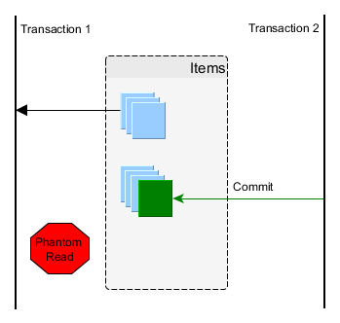
Phantom Read
A phantom read happens when a second transaction inserts a row that matches a previously select criteria of the first transaction.
We therefore end up using stale data, which might affect our business operation.
This is prevented using range locks or predicate locking.

Slide 18
Distributed Databases

Slide 19
Key Principles of Distributed Databases
Distributed database (DDB) - a collection of multiple logically interrelated databases distributed over a computer network
Availability and Reliability
Reliability is the probability that a system is running (not down) at a certain time point
Availability is the probability that the system is continuously available during a time interval.
Autonomy
The extent to which individual nodes or DBs in a connected DDB can operate independently
Design autonomy - independence of data model usage and transaction management techniques among nodes.
Communication autonomy determines the extent to which each node can decide on sharing of information with other nodes.
Execution autonomy refers to independence of users to act as they please.
Transparency
Users and developers should not have to know where data is stored
Scalability and Partition Tolerance
Scalability determines the extent to which the system can expand its capacity while continuing to operate without interruption.

Slide 20
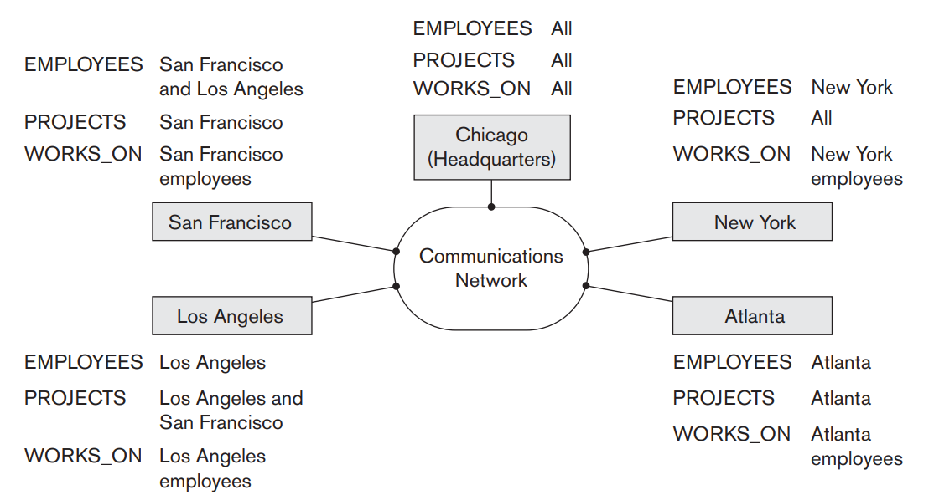
Transparency (1)
Data organization transparency
The freedom for the user from the operational details of the network and the placement of the data in the distributed system. Two freedoms should exist:
Location transparency - commands used to perform a task are independent of the location of the data and the location of the node where the command was issued.
Naming transparency - once a name is associated with an object, the named objects can be accessed unambiguously without additional specification as to where the data is located.
Replication transparency ➔
Copies of the same data objects may be stored at multiple sites for better availability, performance, and reliability.
Replication transparency makes the user unaware of the existence of these copies.

Slide 21
Transparency (1)
Fragmentation transparency. Two types of fragmentation are possible.
Horizontal fragmentation: In an RDBMS, distribute a relation (table) into subrelations that are subsets of the tuples (rows) in the original relation; this is also known as sharding in the newer big data and cloud computing systems.
Vertical fragmentation: In an RDBMS, distribute a relation into subrelations where each subrelation is defined by a subset of the columns of the original relation.
Fragmentation transparency makes the user unaware of the existence of fragments.
Sharding is a type of database partitioning that separates very large databases the into smaller, faster, more easily managed parts called data shards. The word shard means a small part of a whole.

Slide 22
Scalability
Scalability determines the extent to which the system can expand its capacity while continuing to operate without interruption.
Horizontal scalability: This refers to expanding the number of nodes in the distributed system. As nodes are added to the system, it should be possible to distribute some of the data and processing loads from existing nodes to the new nodes.
Vertical scalability: This refers to expanding the capacity of the individual nodes in the system, such as expanding the storage capacity or the processing power of a node.
As the system expands its number of nodes, it is possible that the network, which connects the nodes, may have faults that cause the nodes to be partitioned into groups of nodes. The nodes within each partition are still connected by a subnetwork, but communication among the partitions is lost. The concept of partition tolerance states that the system should have the capacity to continue operating while the network is partitioned.

Slide 23
Transaction Management
ACID still applies to DDBs, but there is also distributed transaction management.
A global transaction manager is introduced for supporting distributed transactions. The site where the transaction originated can temporarily assume the role of global transaction manager and coordinate the execution of database operations with transaction managers across multiple sites.
Transaction managers export their functionality as an interface to the application programs. The operations exported by this interface are essentially BEGIN_TRANSACTION, READ or WRITE, END_TRANSACTION, COMMIT_TRANSACTION, and ROLLBACK

Slide 24
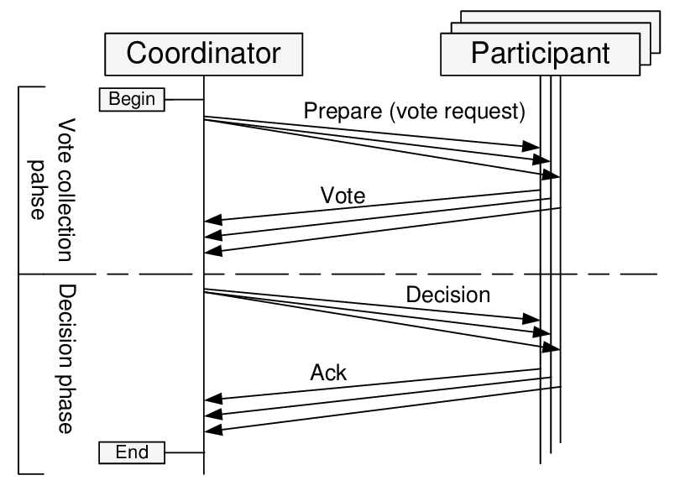
Two-Phase Commit
The net effect of the two-phase commit protocol is that either all participating databases commit the effect of the transaction or none of them do.
In case any of the participants or the coordinator fails, it is always possible to recover to a state where either the transaction is committed or it is rolled back.
A failure during or before phase 1 usually requires the transaction to be rolled back, whereas a failure during phase 2 means that a successful transaction can recover and commit

Slide 25
Two-Phase Commit: The Details
Phase 1 (Prepare Phase)
When all participating nodes signal the coordinator that the part of the multidatabase transaction involving each has concluded, the coordinator sends a message "prepare for commit" to each participant to get ready for committing the transaction.
Each participating database receiving that message will force-write all log records and needed information for local recovery to disk and then send a ready to commit or OK signal to the coordinator.
If the force-writing to disk fails or the local transaction cannot commit for some reason, the participating database sends a cannot commit or not OK signal to the coordinator.
If the coordinator does not receive a reply from the database within a certain time out interval, it assumes a not OK response.
Phase 2 (Commit Phase)
If all participating databases reply OK, and the coordinator’s vote is also OK, the transaction is successful, and the coordinator sends a commit signal for the transaction to the participating databases.
Because all the local effects of the transaction and information needed for local recovery have been recorded in the logs of the participating databases, local recovery from failure is now possible.
Each participating database completes transaction commit by writing a [commit] entry for the transaction in the log and permanently updating the database if needed.
Conversely, if one or more of the participating databases or the coordinator have a not OK response, the transaction has failed, and the coordinator sends a message to roll back or UNDO the local effect of the transaction to each participating database.
This is done by undoing the local transaction operations, using the log

Slide 26
Two-Phase Commit: Protocol Diagram
Force-write: write to durable memory (disk) log records but do not commit to the database
For UPDATEs, the before and after image of the record(s) are written
Transaction Succeeds
Transaction Fails
Transaction Coordinator
Transaction Coordinator
Node 1
Node 2
Node 1
Node 2
Can you commit?
Can you commit?
Prepare Phase
Can you commit?
Can you commit?
Force-write to log;
Perform DB action
Force-write to log;
Perform DB action
Force-write to log;
Perform DB action
Abort DB action
YES
YES
YES
NO
Commit!
Commit!
Commit Phase
Rollback!
Commit (force-write to DB)
Commit (force-write to DB)
Rollback
ACK
ACK
ACK

Slide 27
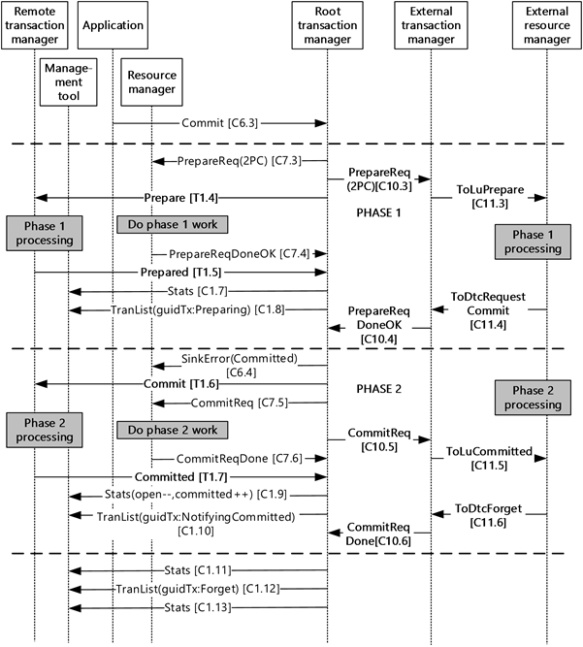
Real-life Architectures
Real life architectures adhere to the two-phase commit protocol, but can introduce multiple players or control mechanisms.
This is Microsoft's architecture

Slide 28
Connect to DB Server

Slide 29
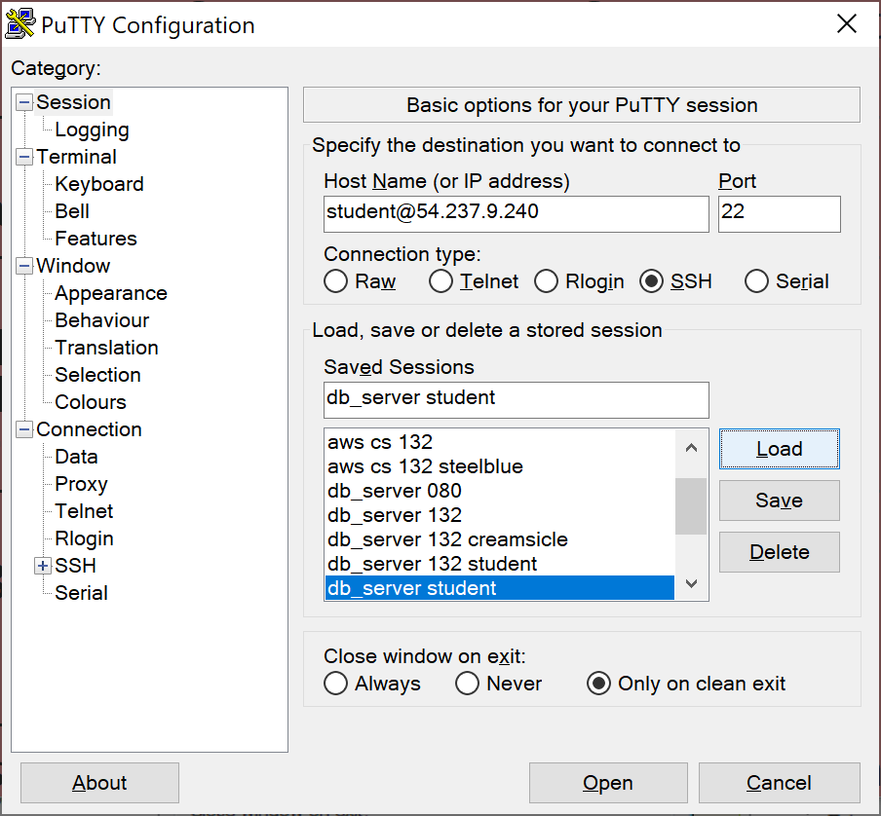
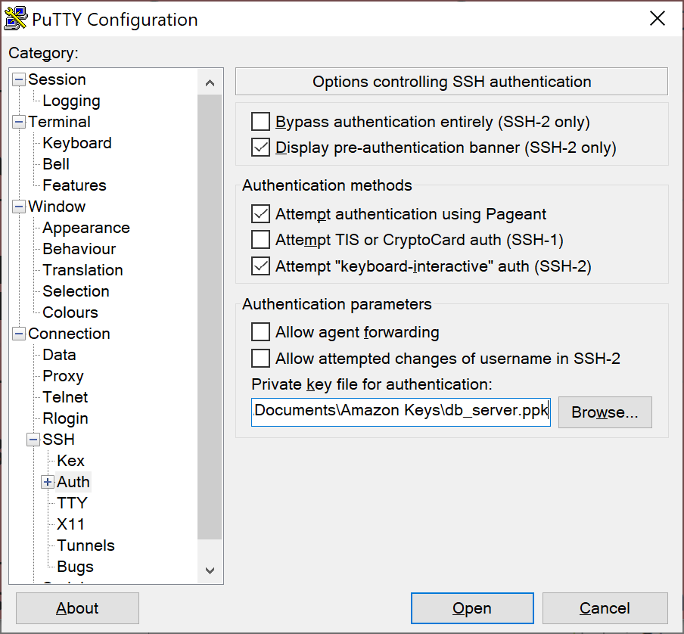

Connecting to the DB Server

Slide 30
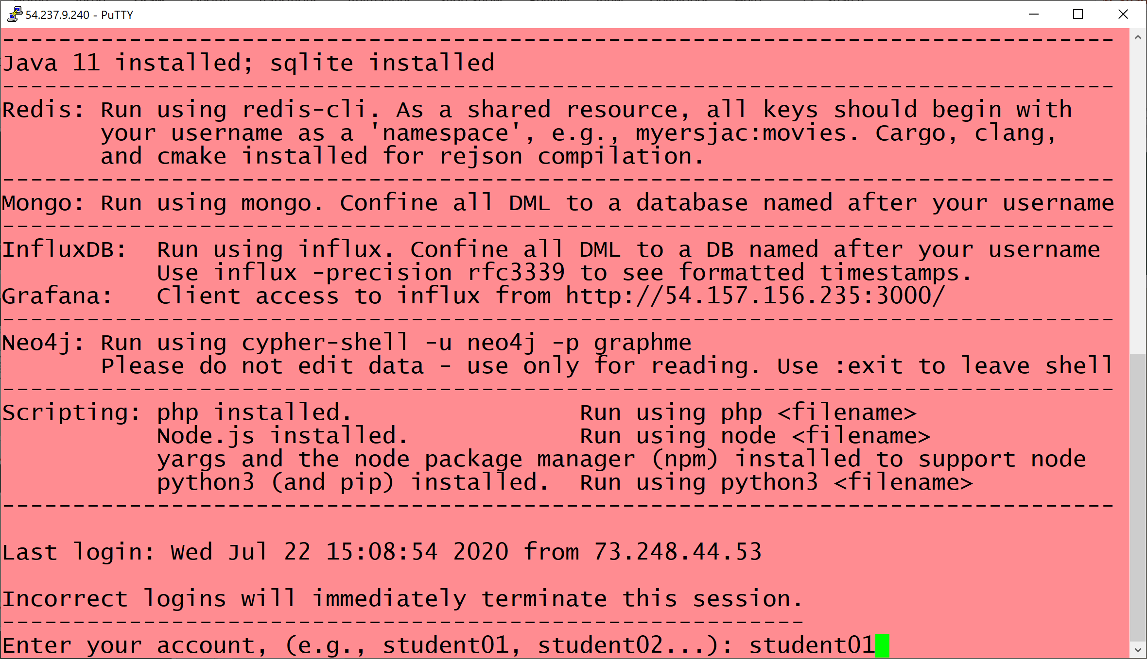
Then enter your student account

Slide 31
Supplemental
Network Segment-ation and CAP

Slide 32
Network Partitions: Subnets
A subnet is a logical subdivision of an IP network.
Subnets are defined by / notation
Consider IP address 200.40.19.0
Mask 24 does not divide the IP address range. Thus 200.40.19.0/24 translates to all 256 IP addresses for hosts.
From 200.40.19.0 to 200.40.19.255
Mask 25 divides the IP address range in half, thus 126 IP addresses for hosts (the first and last address in any network or subnet cannot be assigned to any individual host.)
200.40.19.0/25 ➔ 200.40.19.1 to 200.40.19.127 - and –
200.40.19.0/25 ➔ 200.40.19.129 to 200.40.19.254
Mask 26 divides the IP address range in fourths, thus 62 IP addresses each

Slide 33
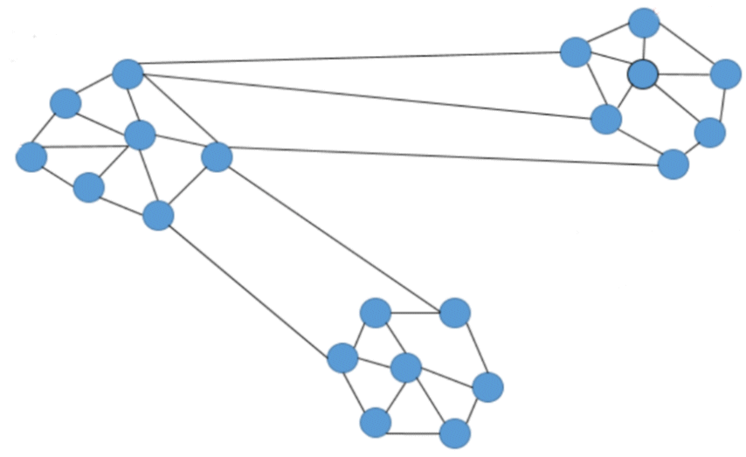
Partition Tolerance
200.40.19.64/25
200.40.19.0/25
200.40.19.128/25
Failed node
A system that is partition-tolerant can sustain any amount of network failure that doesn’t result in a failure of the entire network.
Failed nodes are ok, but if the network connection fails

